Slide 1

Multi-Class Detection of Laparoscopic Instruments for the Intelligent Box-Trainer System Using Faster R-CNN Architecture
SAMI2021
IEEE 19th World Symposium on Applied Machine Intelligence and Informatics

Slide 2





SAMI2021
IEEE 19th World Symposium on Applied Machine Intelligence and Informatics
Fatemeh Rashidi Fathabadi Department of Electrical &
Computer Engineering Western Michigan University Michigan, USA
Janos L. Grantner Department of Electrical &
Computer Engineering Western Michigan University
Michigan, USA
Saad A. Shebrain Department of Surgery, Homer Stryker
M.D. School of Medicine Western Michigan University Michigan, USA
Ikhlas Abdel-Qader Department of Electrical &
Computer Engineering
Western Michigan University Michigan, USA

Slide 3

Agenda
Introduction
Methodology
Results
Summary
Introduction
Literature Review
Object detection
Methodology
Procedure for Laparoscopic Instrument Detection
Data Collection
Data Preparation
PyTorch
Choosing a Model
Training the Model
Predictions
Results
Detections of laparoscopic surgical instruments
Summary and Future Research
SAMI2021
IEEE 19th World Symposium on Applied Machine Intelligence and Informatics

Slide 4
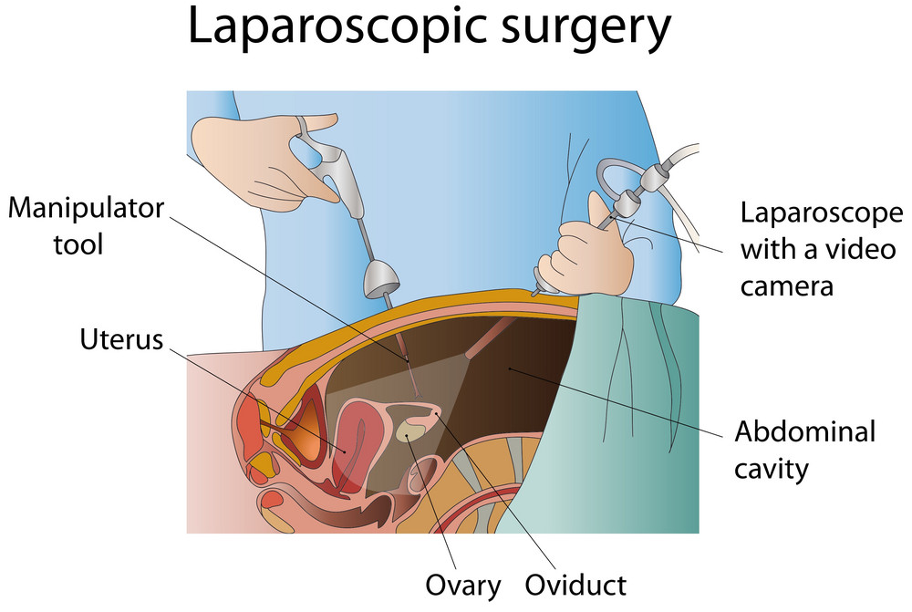
Literature Review
Introduction
Methodology
Results
Summary
Minimally Invasive Surgery (MIS)
Operating using smallest incisions
Shortest recovery
Providing the surgeon with the field view using cameras
Reduces complications and health risks
Decreases hospital stay
SAMI2021
IEEE 19th World Symposium on Applied Machine Intelligence and Informatics

Slide 5
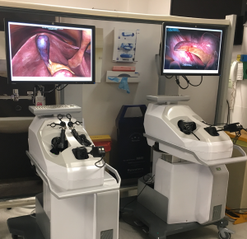
Literature Review
Introduction
Methodology
Results
Summary
Virtual Reality (VR) Trainers
Educational tools for the attainment of MIS surgery skills such as:
Strong eye-hand coordination while operating using visual information from the two-dimensional images
Control on the graspers and new challenging skills
Developing skills without error risks
Improve operating room (OR) performance
SAMI2021
IEEE 19th World Symposium on Applied Machine Intelligence and Informatics

Slide 6
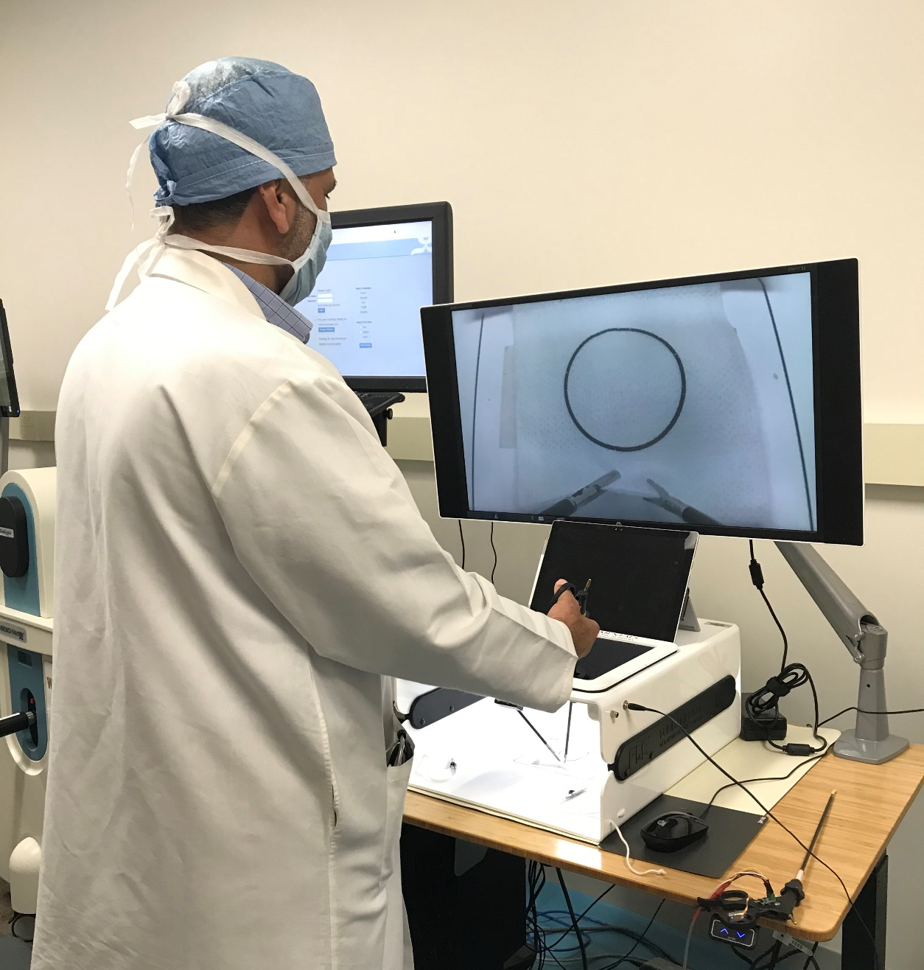
Literature Review
Introduction
Methodology
Results
Summary
Laparoscopic Surgical Box-trainer
Equipped with:
Cameras
Monitor
Light source
Needle holder, scissors, and grasper
Allows the trainees to practice laparoscopic techniques in a low-cost environment
SAMI2021
IEEE 19th World Symposium on Applied Machine Intelligence and Informatics

Slide 7
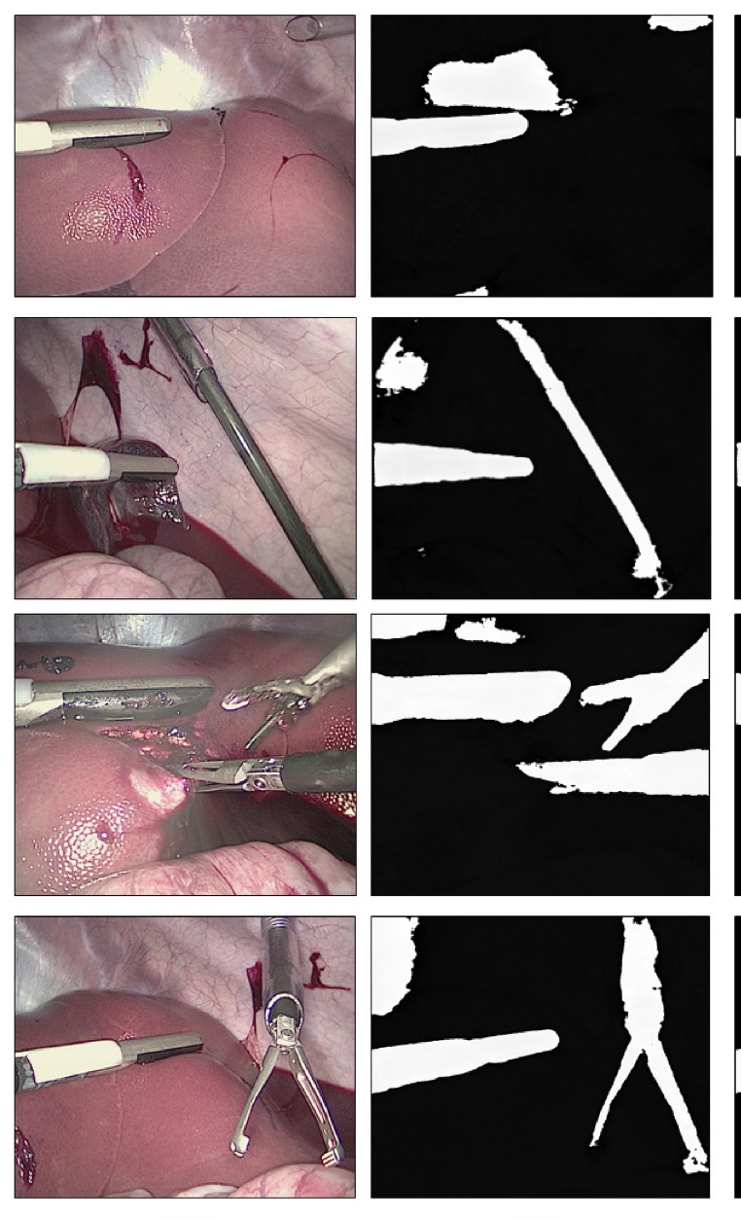
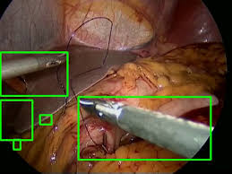
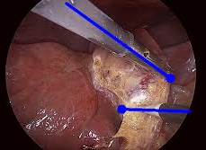
Literature Review
Introduction
Methodology
Results
Summary
Related Work
Laparoscopic instrument detection and tool-tip tracking algorithms:
Gradient-based features
Color detection
Haar wavelets
Texture features
Edge detection method
Deep Learning methods
Convolutional Neural Networks (CNN)
Recurrent Neural Networks (RNN)
Image segmentation
SAMI2021
IEEE 19th World Symposium on Applied Machine Intelligence and Informatics

Slide 8
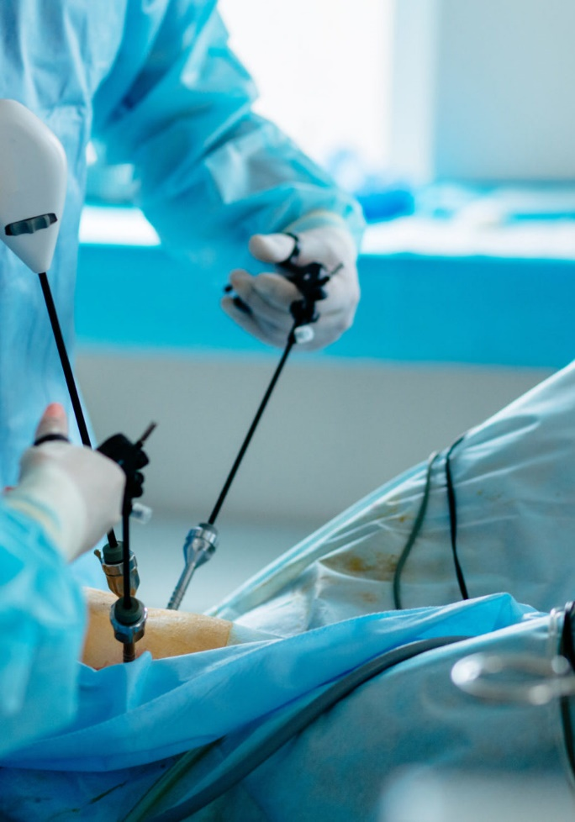
Object Detection
Introduction
Methodology
Results
Summary
A computer technology related to computer vision and image processing
Detecting instances of semantic objects of a certain class (such as humans, buildings, or cars) in digital images and videos
In this study we used deep learning algorithm
SAMI2021
IEEE 19th World Symposium on Applied Machine Intelligence and Informatics

Slide 9

Procedure for Laparoscopic Instrument Detection
Introduction
Results
Summary
Methodology
Data collection
Data preparation
Choosing a model
Training the model
Making predictions
SAMI2021
IEEE 19th World Symposium on Applied Machine Intelligence and Informatics
Notes:
Our custom dataset consists of extracted frames of these videos which have been manually annotated using the Image Annotation Tool – LabelImg which is a free and open source tool software

Slide 10
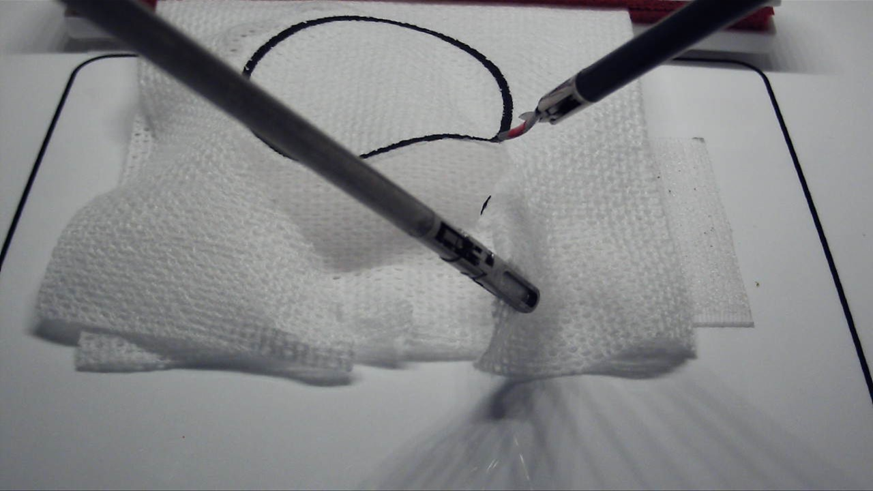
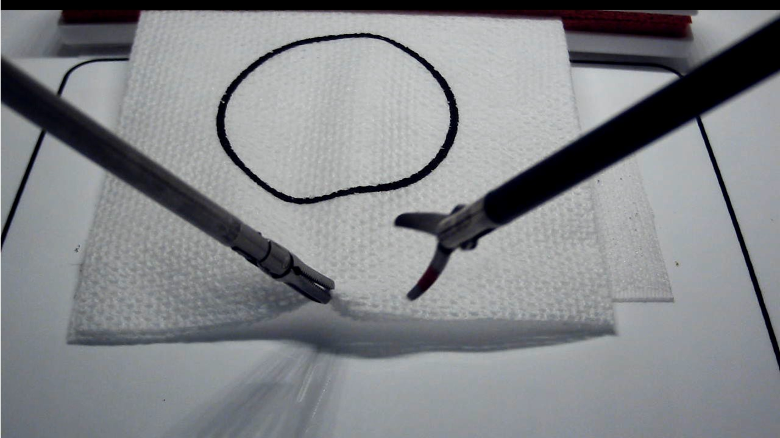
Data Collection
Introduction
Results
Summary
Methodology
In the field of laparoscopic surgical box-trainer research there are no published datasets
We have recorded many videos during pattern cutting tests procedure using our FLS box-trainer
Our datasets consist of extracted frames of laparoscopic training videos
We aim to release this dataset in public, so that other researchers can benefit from it
We manually annotated each image using the Image Annotation Tool – LabelImg- an open-source image labeling tool
SAMI2021
IEEE 19th World Symposium on Applied Machine Intelligence and Informatics
Notes:
Our custom dataset consists of extracted frames of these videos which have been manually annotated using the Image Annotation Tool – LabelImg which is a free and open source tool software

Slide 11
Data Preparation
Introduction
Results
Summary
Methodology
Partitioning of the Dataset
Typically, the ratio of this arrangement is 6:2:2
60% of the images for training the model
20% of the images for validation during training in each epoch
The remaining 20% for testing
SAMI2021
IEEE 19th World Symposium on Applied Machine Intelligence and Informatics
Notes:
Our custom dataset consists of extracted frames of these videos which have been manually annotated using the Image Annotation Tool – LabelImg which is a free and open source tool software

Slide 12
Data Preparation
Introduction
Results
Summary
Methodology
Creating a Label Map
item {
id: 1
name: 'Scissor'
}
item {
id: 2
name: 'Grasper'
}
id: 3
name: 'Circle'
}
Each training algorithm requires a label map
It maps each of the labels (classes) to an integer value
It is used both by the training and the detection processes
SAMI2021
IEEE 19th World Symposium on Applied Machine Intelligence and Informatics
Notes:
Our custom dataset consists of extracted frames of these videos which have been manually annotated using the Image Annotation Tool – LabelImg which is a free and open source tool software

Slide 13
Data Preparation
Introduction
Results
Summary
Methodology
Data Augmentation
Details of the dataset per instruments before and after image augmentation
Geometric transformations for data augmentation:
Translations
Rotations
Changes in scale
Shearing
Horizontal (and in some cases, vertical) flips
Instrument | Available size | Augmented size
Scissors | 300 | 640
Grasper | 280 | 485
Circle | 370 | 695
Total | 950 | 1820
SAMI2021
IEEE 19th World Symposium on Applied Machine Intelligence and Informatics
Notes:
Our custom dataset consists of extracted frames of these videos which have been manually annotated using the Image Annotation Tool – LabelImg which is a free and open source tool software

Slide 14

PyTorch
Introduction
Results
Summary
Methodology
PyTorch is:
An open-source machine learning library
Based on the Torch library
Used for applications such as computer vision and natural language processing, object detection
SAMI2021
IEEE 19th World Symposium on Applied Machine Intelligence and Informatics
Notes:
TensorFlow is a frequently used software for Machine Learning (ML) applications, providing an interface to represent common ML algorithms and executable code for different models

Slide 15
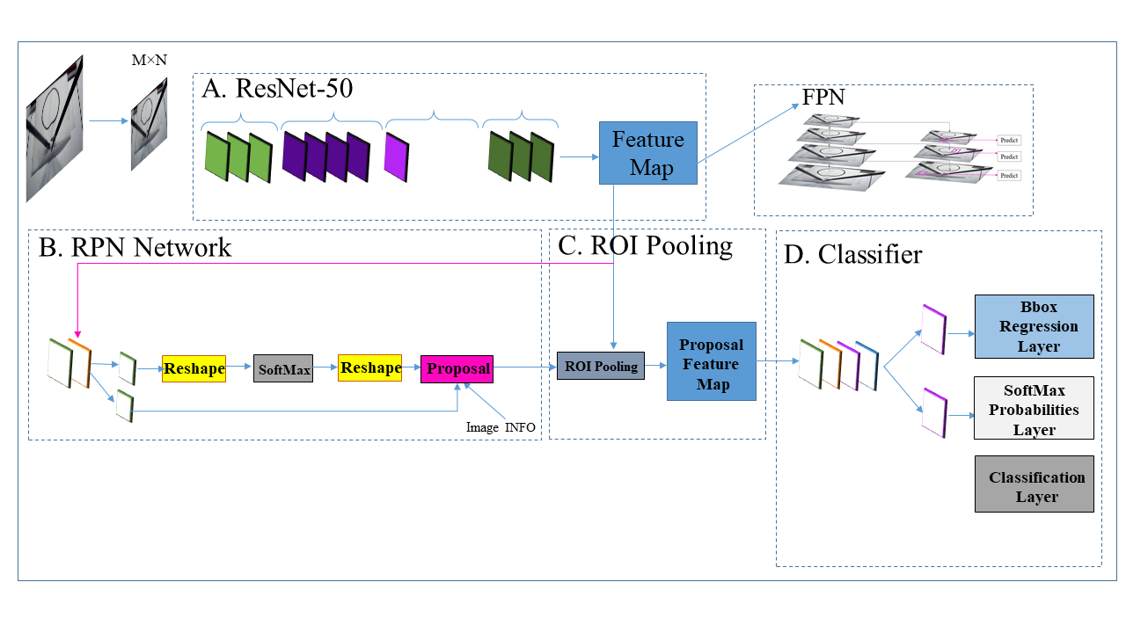
Choosing Model
Introduction
Results
Summary
Methodology
Faster R-CNN ResNet-50 FPN Architecture
A: ResNet-50
B: the RPN classifies scores and bounding boxes (Bbox) of the proposal regions by localizing each object
C: the last conv feature map connects to a RoI Pooling Layer, connected to the proposal region
D: Classifier, there are two output layers of Fast R-CNN, representing two vectors per proposal region: SoftMax probabilities and Bbox regression
SAMI2021
IEEE 19th World Symposium on Applied Machine Intelligence and Informatics

Slide 16
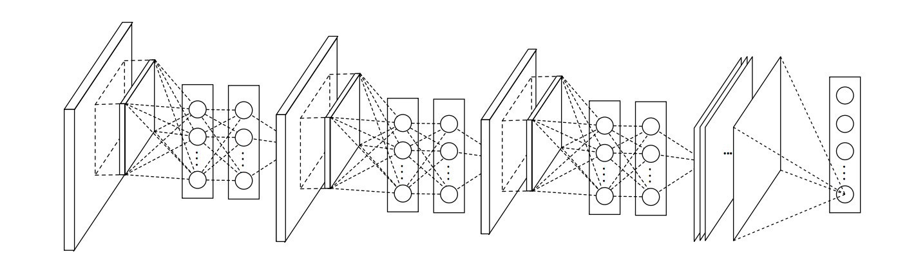
Training the Model
Introduction
Results
Summary
Methodology
Datasets are usually grouped into batches (especially when the amount of data is very large).
An epoch is a term used in machine learning and indicates the number of passes of the entire training dataset the machine learning algorithm has completed.
After the training data is prepared and the model is selected, we train the model to a specific number of epochs.
SAMI2021
IEEE 19th World Symposium on Applied Machine Intelligence and Informatics

Slide 17
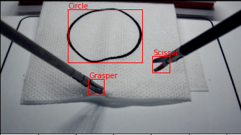
Predictions
Introduction
Results
Summary
Methodology
The performance of a model is tested by making predictions on new images.
The testing data is used to see if a model is capable of predicting the surgical instruments on images which haven’t been trained.
The output of the of the detected object is then compared with the label map to evaluate whether the predicted instruments is correct or not.
SAMI2021
IEEE 19th World Symposium on Applied Machine Intelligence and Informatics

Slide 18
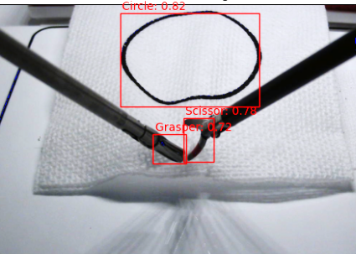
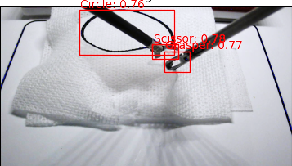
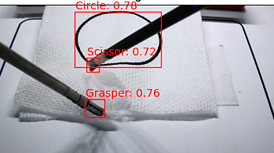
Detections
Introduction
Results
Summary
Methodology
SAMI2021
IEEE 19th World Symposium on Applied Machine Intelligence and Informatics

Slide 19
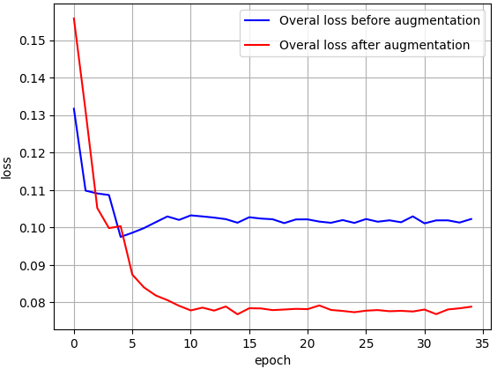
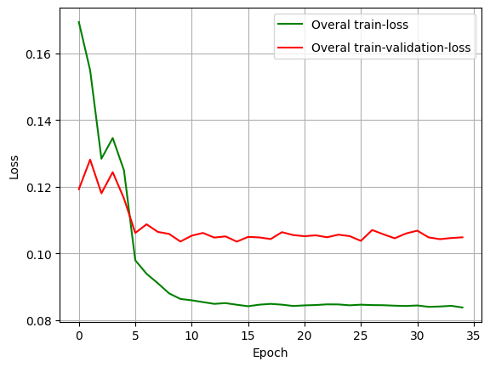
Detections
Introduction
Results
Summary
Methodology
Quantitative & Qualitative Discussion
Total Loss:
Classification: determining the existence of an object in the image
Localization: determining the location of a region of interest of the object in the image using the regression method
Bounding Box Score | Instrument
 | Scissors | Grasper | Circle
Score after 15 epochs | 0.6367 | 0.7416 | 0.8715
Score after 25 epochs | 0.7658 | 0.6273 | 0.7875
Score after 35 epochs | 0.7937 | 0.7209 | 0.8324
SAMI2021
IEEE 19th World Symposium on Applied Machine Intelligence and Informatics

Slide 20
Summary and Future Research
Introduction
Results
Summary
Methodology
Importance of training experienced and skilled laparoscopic surgeons
The performance of a laparoscopic surgeon with respect to the movements of the tool tips
Preparing a dataset for future research in assessment of the residents’ performance
A multi-class laparoscopic object detection method using a Faster R-CNN Architecture
The module predicts each laparoscopic instrument
In future research, we plan to assess the performance of surgeons using fuzzy logic assessment system.
SAMI2021
IEEE 19th World Symposium on Applied Machine Intelligence and Informatics

Slide 21
Thank you for your attention!

